Slide 1
Notes:
Chapter 18 is not particularly difficult, but students find it very interesting. It deals with important policy issues related to the theories students have learned from this book.

Slide 2
IN THIS CHAPTER, YOU WILL LEARN:
about two policy debates:
Should policy be active or passive?
Should policy be by rule or discretion?
1

Slide 3
Question 1:
Should policy be active or passive?
?

Slide 4
Growth rate of U.S. real GDP
Percent change from 4 quarters earlier
Average growth rate
Notes:
This graph is from Chapter 10. I include it here as it shows that GDP is very volatile. Question 1 asks whether policymakers should attempt to smooth out these fluctuations by using fiscal and monetary policy to alter aggregate demand.
The pink shaded vertical bars denote recessions.
Source of data: U.S. Department of Commerce.

Slide 5
Increase in unemployment during recessions
peak | trough | increase in no. of unemployed persons (millions)
July 1953 | May 1954 | 2.11
Aug 1957 | April 1958 | 2.27
April 1960 | February 1961 | 1.21
December 1969 | November 1970 | 2.01
November 1973 | March 1975 | 3.58
January 1980 | July 1980 | 1.68
July 1981 | November 1982 | 4.08
July 1990 | March 1991 | 1.67
March 2001 | November 2001 | 1.50
December 2007 | June 2009 | 6.14
Notes:
During a recession, many people lose their jobs (the average for the recessions shown in this table is 2.2 million).
Advocates for activist policy believe that policymakers should use the fiscal and monetary policy tools at their disposal to try to reduce the length and severity of recessions, or prevent them if possible.
Source:
Business cycle dates from nber.org
Increase in unemployment from U.S. Department of Labor, Bureau of Labor Statistics (via FRED, the St Louis Fed’s online database)

Slide 6
Arguments for active policy
Recessions cause economic hardship for millions of people.
The Employment Act of 1946: “It is the continuing policy and responsibility of the Federal Government to…promote full employment and production.”
The model of aggregate demand and supply (Chaps. 10–14) shows how fiscal and monetary policy can respond to shocks and stabilize the economy.

Slide 7
Arguments against active policy
Policies act with long & variable lags, including:
inside lag: the time between the shock and the policy response.
takes time to recognize shock
takes time to implement policy, especially fiscal policy
outside lag: the time it takes for policy to affect economy.
If conditions change before policy’s impact is felt, the policy may destabilize the economy.
Notes:
Opponents of policy activism argue that long & variable lags hinder the effectiveness of policy.
Fiscal policy requires an act of Congress. As your students may be aware, the process by which a bill becomes a law is lengthy and involved, and often fraught with political difficulty.
Monetary policy has a much shorter inside lag. However, firms make their investment plans in advance, so it takes time for interest rate changes to affect investment and aggregate demand.
Opponents of policy activism note that the lags are long and uncertain, making it very difficult to predict the impact of policy, which makes it difficult to determine the appropriate policy.
If you have a blackboard or whiteboard handy, you might draw for students the AD/AS diagram with the economy initially in a full-employment equilibrium. Then:
Show the short-run effects of a negative AD shock.
From the new short-run equilibrium, illustrate how an activist policy of increasing AD can get the economy back to full-employment.
Finally, repeat step 2, but assume that the policy acts with a lag, during which time the economy’s “self-correcting” mechanism is already well underway. The result should be that the AD shift actually pushes the economy over too far to the right, so that Y is greater than the full-employment level. Thus, policy meant to reduce a negative demand shock actually causes a positive shock. Of course, after this positive shock occurs, activist policymakers might try to contract aggregate demand; but again, if there’s a lag, then they might put the economy back into recession.

Slide 8
Automatic stabilizers
definition: policies that stimulate or depress the economy when necessary without any deliberate policy change.
Designed to reduce the lags associated with stabilization policy.
Examples:
income tax
unemployment insurance
welfare
Notes:
Why the income tax is an automatic stabilizer:
Each person’s tax bill depends on his or her income. In a recession, average incomes fall, so the average person pays less taxes. It’s as if the government automatically gives people a tax cut in recessions.
Why unemployment insurance is an automatic stabilizer:
In a recession, people who become unemployed experience a fall in their income, and therefore reduce their spending, which further reduces aggregate demand. Unemployment insurance reduces the fall in the income of the unemployed, and so helps to reduce the drop in aggregate demand during a recession. Welfare performs a similar function.

Slide 9
Forecasting the macroeconomy
Because policies act with lags, policymakers must predict future conditions.
Two ways economists generate forecasts:
Leading economic indicators (LEI) data series that fluctuate in advance of the economy
Macroeconometric models Large-scale models with estimated parameters that can be used to forecast the response of endogenous variables to shocks and policies
Notes:
The macroeconometric models are, in many cases, more elaborate versions of the IS-LM-AD-AS model that students learned in the preceding chapters. The parameters of each equation (e.g., the MPC or the interest rate sensitivity of investment) are estimated with real-world data; then, by changing the values of the exogenous variables, or by specifying price shocks or other changes, the macroeconometric models generate forecasts of all the endogenous variables (GDP, interest rates, unemployment, inflation) at various time horizons following the shock or or policy change.

Slide 10
The LEI index and real GDP, 1960s
source of LEI data: The Conference Board
Notes:
This and the next few slides show the annual growth rates of real GDP and the Index of Leading Economic Indicators (listed in Chapter 10). There is one slide for each decade from the 1960s through the 1990s.
You can ask your students to identify periods in which the LEI does a good job forecasting real GDP. One thing that becomes clear: the sign and size of the change in the LEI is a very imperfect predictor of the sign and size of the change in real GDP.
Note: If you wish to save time, you can probably get the idea across with just one or two of these four slides—pick your favorite decade(s), and “hide” the slides for the other decades.

Slide 11
The LEI index and real GDP, 1970s
source of LEI data: The Conference Board

Slide 12
The LEI index and real GDP, 1980s
source of LEI data: The Conference Board

Slide 13
The LEI index and real GDP, 1990s
source of LEI data: The Conference Board

Slide 14
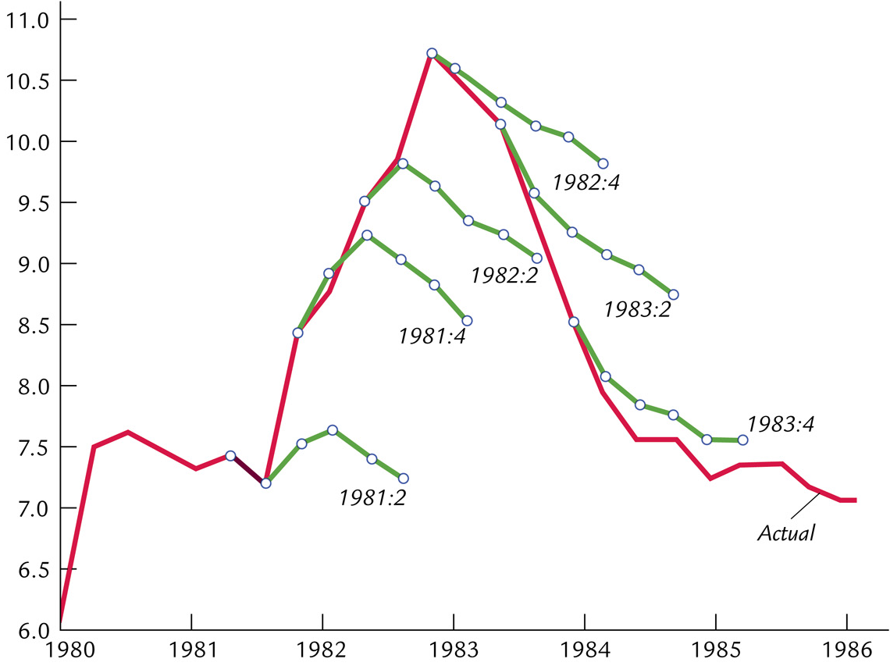
Mistakes forecasting the 1982 recession
Unemployment rate
Notes:
This is similar to Figure 18-1 on p.536 of the textbook; it covers a different recession.
The red line is the actual unemployment rate. Each green line represents the median of 20 forecasts of the unemployment rate at the date shown. The first three forecasts all failed to predict the severity of the recession (each shows unemployment falling after a quarter or two, when in fact the unemployment rate kept rising). The last three forecasts failed to predict the speed of the recovery.
Similarly, a consensus of forecasts in November 2007 predicted that U.S. unemployment would rise from 4.7% at the end of 2007 to 5.0% at the end of 2008. In May 2008, the consensus forecast was that unemployment would reach 5.5% by the end of 2008. These forecasts were far off the mark: unemployment reached 6.7% in the fourth quarter of 2008.
The point here is that forecasts are often not accurate, which opponents of activist policy emphasize. And without accurate forecasts, policies that act with uncertain lags may end up destabilizing the economy.

Slide 15
Forecasting the macroeconomy
Because policies act with lags, policymakers must predict future conditions.
The preceding slides show that the forecasts are often wrong.
This is one reason why some economists oppose policy activism.

Slide 16
The Lucas critique
Due to Robert Lucas who won Nobel Prize in 1995 for his work on rational expectations.
Forecasting the effects of policy changes has often been done using models estimated with historical data.
Lucas pointed out that such predictions would not be valid if the policy change alters expectations in a way that changes the fundamental relationships between variables.

Slide 17
An example of the Lucas critique
Prediction (based on past experience): An increase in the money growth rate will reduce unemployment.
The Lucas critique points out that increasing the money growth rate may raise expected inflation, in which case unemployment would not necessarily fall.
Notes:
Remember the expectations-augmented Phillips curve from Chapter 14:
An increase in money growth and inflation only reduces unemployment if expected inflation remains unchanged. Perhaps that was the case in the past. But now, if the money growth increase causes people to raise their expectations of inflation, then unemployment won’t fall.

Slide 18
The Jury’s out…
Looking at recent history does not clearly answer Question 1:
It’s hard to identify shocks in the data.
It’s hard to tell how outcomes would have been different had actual policies not been used.
Notes:
Greg sums it up nicely on pp.537-538:
“If the economy has experienced many large shocks to aggregate supply and aggregate demand, and if policy has successfully insulated the economy from these shocks, then the case for active policy should be clear. Conversely, if the economy has experienced few large shocks, and if the fluctuations we have observed can be traced to inept economic policy, then the case for passive policy should be clear….Yet…it is not easy to identify the sources of economic fluctuations. The historical record often permits more than one interpretation. The Great Depression is a case in point….Some economists believe that a large contractionary shock to private spending caused the depression. They assert that policymakers should have responded by stimulating aggregate demand. Other economists believe that the large fall in the money supply caused the Depression. They assert that the Depression would have been avoided if the Fed had been pursuing a passive monetary policy of increasing the money supply at a steady rate.”

Slide 19
Question 2:
Should policy be conducted by rule or discretion?
?

Slide 20
Rules and discretion: Basic concepts
Policy conducted by rule: Policymakers announce in advance how policy will respond in various situations and commit themselves to following through.
Policy conducted by discretion: As events occur and circumstances change, policymakers use their judgment and apply whatever policies seem appropriate at the time.

Slide 21
Arguments for rules
1. Distrust of policymakers and the political process
misinformed politicians
politicians’ interests sometimes not the same as the interests of society
Notes:
Note: these are arguments made by critics of policy by discretion. Please be clear that it is not our intention to say that politicians are misinformed or acting against society; rather, this is what is alleged by proponents of policy by rules.

Slide 22
Arguments for rules
2. The time inconsistency of discretionary policy
def: A scenario in which policymakers have an incentive to renege on a previously announced policy once others have acted on that announcement.
Destroys policymakers’ credibility, thereby reducing effectiveness of their policies.

Slide 23
Examples of time inconsistency
1. To encourage investment, govt announces it will not tax income from capital.
But once the factories are built, govt reneges in order to raise more tax revenue.

Slide 24
Examples of time inconsistency
2. To reduce expected inflation, the central bank announces it will tighten monetary policy.
But faced with high unemployment, the central bank may be tempted to cut interest rates.

Slide 25
Examples of time inconsistency
3. Aid is given to poor countries contingent on fiscal reforms.
The reforms do not occur, but aid is given anyway, because the donor countries do not want the poor countries’ citizens to starve.

Slide 26
Monetary policy rules
a. Constant money supply growth rate
Advocated by monetarists.
Stabilizes aggregate demand only if velocity is stable.
Notes:
The preceding slides gave some arguments against discretionary policy. This and the following slides describe the alternative: policy by rule. In particular, rules for monetary policy.

Slide 27
Monetary policy rules
a. Constant money supply growth rate
b. Target growth rate of nominal GDP
Automatically increase money growth whenever nominal GDP grows slower than targeted; decrease money growth when nominal GDP growth exceeds target.

Slide 28
Monetary policy rules
a. Constant money supply growth rate
b. Target growth rate of nominal GDP
c. Target the inflation rate
Automatically reduce money growth whenever inflation rises above the target rate.
Many countries’ central banks now practice inflation targeting but allow themselves a little discretion.

Slide 29
Central bank independence
A policy rule announced by central bank will work only if the announcement is credible.
Credibility depends in part on degree of independence of central bank.
Notes:
We have seen this issue in Chapter 14:
If the Fed credibly announces a new commitment to bring inflation down, then expected inflation will fall, reducing the sacrifice ratio.
If the Fed’s announcement is not credible, then expected inflation will not fall, and a painful recession will be required to bring inflation down.

Slide 30
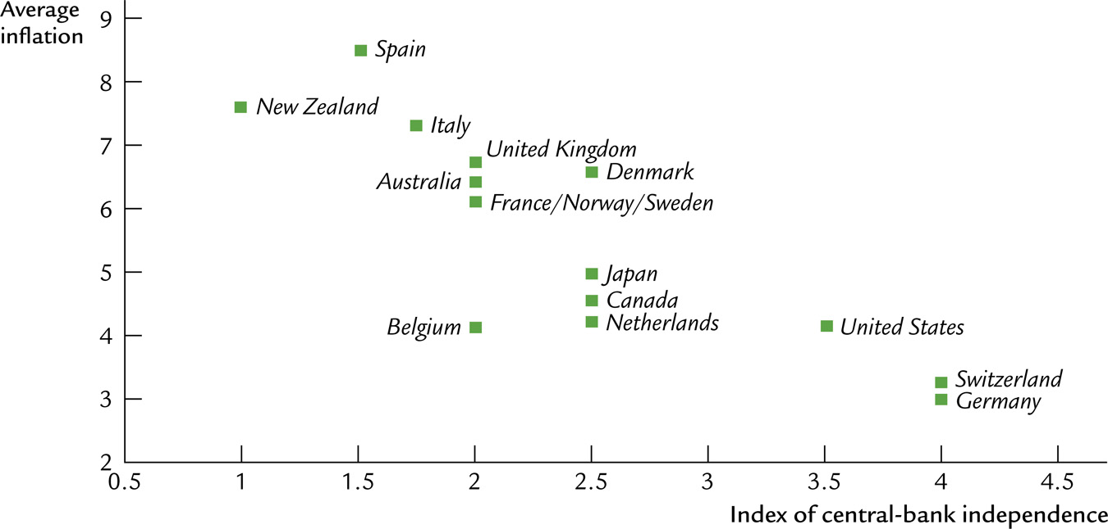
Inflation and central bank independence
average inflation
index of central bank independence
Notes:
This figure shows a measure of the independence of various countries’ central banks (higher numbers = greater independence). One would expect higher average inflation in countries whose central banks are less independent, as monetary policy could be used for political purposes (e.g., lowering unemployment prior to elections). And the graph shows that this is the case.
This graph appears on p.547 of the text as Figure 18-3 , and was originally in Alesina and Summers, “Central Bank Independence and Macroeconomic Performance: Some Comparative Evidence,” Journal of Money, Credit, and Banking, May 1993.

Slide 31
CHAPTER SUMMARY
1. Advocates of active policy believe:
frequent shocks lead to unnecessary fluctuations in output and employment.
fiscal and monetary policy can stabilize the economy.
2. Advocates of passive policy believe:
the long & variable lags associated with monetary and fiscal policy render them ineffective and possibly destabilizing.
inept policy increases volatility in output, employment.
30

Slide 32
CHAPTER SUMMARY
3. Advocates of discretionary policy believe:
discretion gives more flexibility to policymakers in responding to the unexpected.
4. Advocates of policy rules believe:
the political process cannot be trusted: Politicians make policy mistakes or use policy for their own interests.
commitment to a fixed policy is necessary to avoid time inconsistency and maintain credibility.
31

